Slide 1
Merchandise Recommendation Engine
(Recommends merchandise products on Bank Portals)
-Tanvi Patil
(Oct 2020)

Slide 2
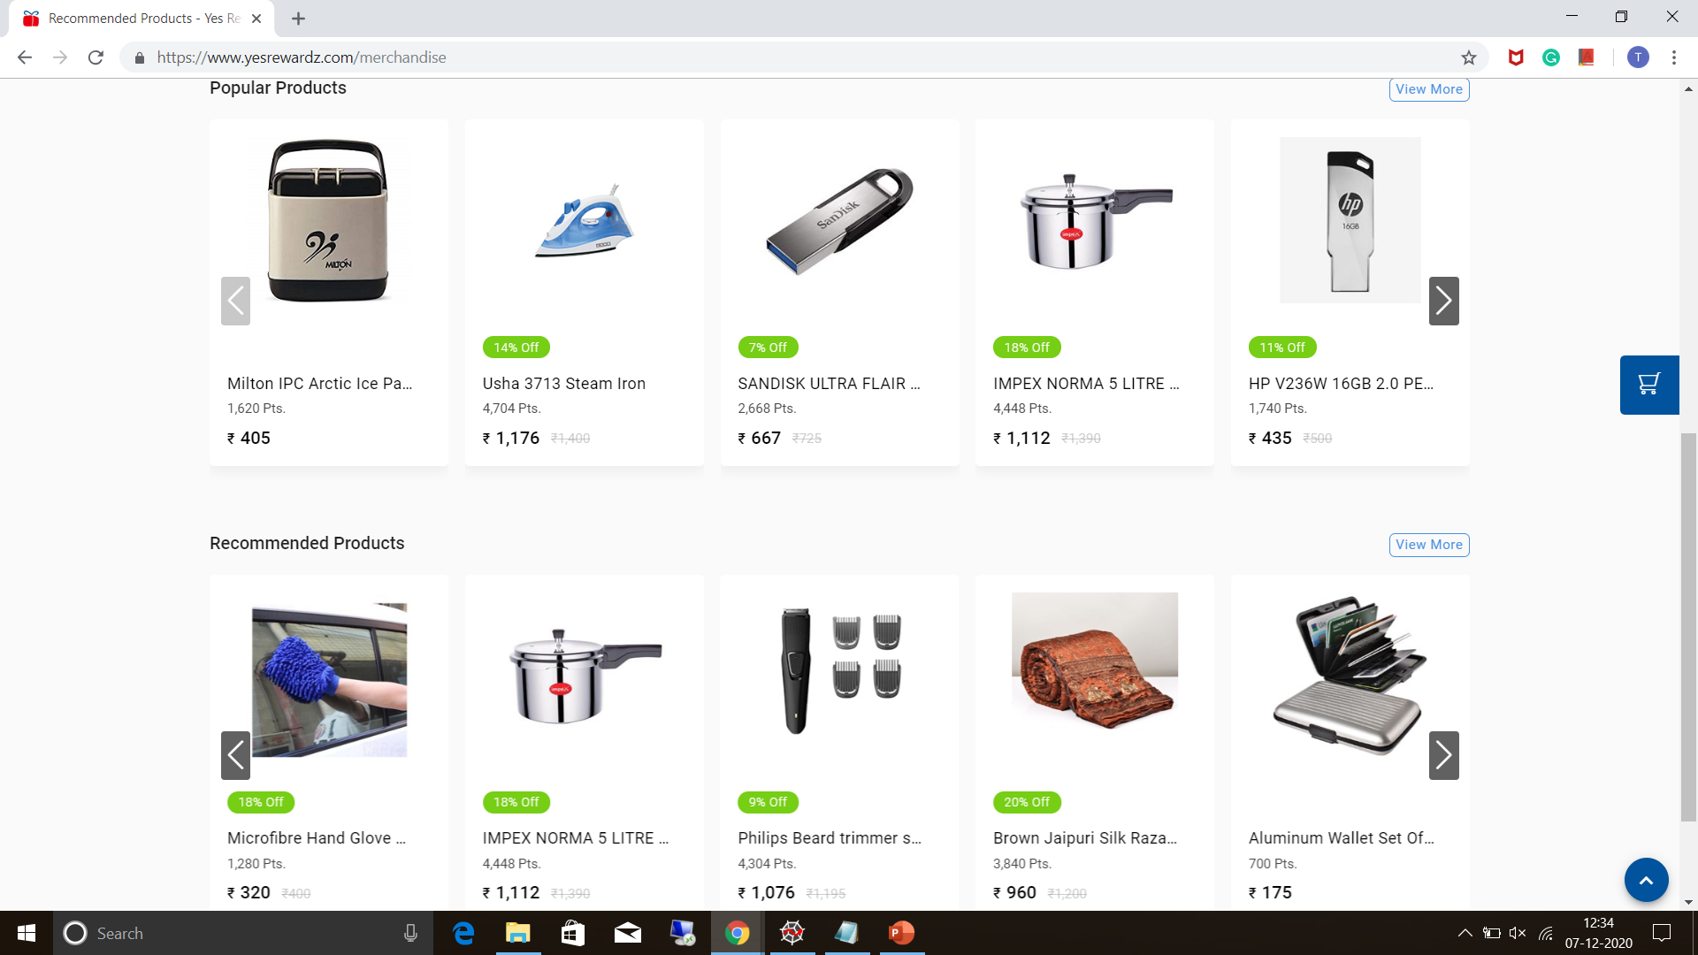

Slide 3
Redemption data distribution
Year – wise portal redemption count of top 6 Banks.
(0.44% )
(99.56% )
Old Redeemers
New Redeemers

Slide 4
Data Inconsistency
Issues in combining old redemption data and new redemption data post migration.
No common primary key
Productid had different formats
SKUs mapped to same product were different in both data
Category and subcategory assigned to a product was not same for old and new data.
Manually assigned category and subcategory matching with the category and subcategory of new data.
Assigned new SKUs to old data with the help of matched category and subcategory.
Notes:
Productid, SKU, product category subcategory
60% of time was put in getting rid of this inconsistency/variability.
Primary key SKU.

Slide 5
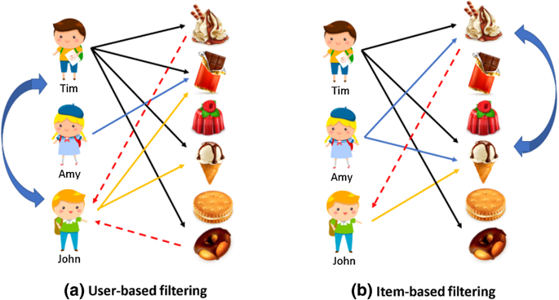
Collaborative Filtering
This method recommends products based on past interactions between users and items.
Create clusters of similar users based on user profile
Create clusters of similar items based on item profile
Notes:
This method recommends products on the basis of past interactions between users and items.
Issue: Adding new users/items to the system or cold start: taken care by content based filtering
There are two approaches: the first one identifies clusters of users and utilizes the interactions of one specific user to predict the interactions of other similar users.

Slide 6
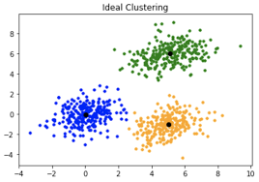
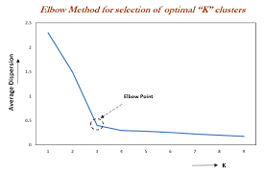
K Means Clustering
Elbow Method
Obtaining the optimal number of clusters based on a trade off between computational power and average distance of data points from centroid.
Notes:
the sum of square distances from each point to its assigned center.
Compact clusters → more similar, more accurately u could predict the behavior

Slide 7
Apriori Algorithm
Apriori Algorithm extracts ruleset from the redemption transactions of similar users from each cluster
Redeemed Category(X) | Recommended Category(Y) | confidence | support_Y | support_X | lift | clusternumber
storage & containers | photo frames | 0.0572246 | 0.027521 | 2.18604 | 2.0793 | 2
hair care | perfumes & deos | 1.43113 | 0.993257 | 0.349642 | 1.4408 | 2
beauty & grooming | men | 3.69458 | 1.62058 | 1.39103 | 2.2798 | 3
home entertainment | beauty & grooming | 1.57233 | 1.39103 | 1.08953 | 1.1303 | 3
hair care | perfumes & deos | 2.77778 | 0.87025 | 0.123343 | 3.1919 | 3
tvs | appliances | 33.3333 | 0.63727 | 0.010279 | 52.306 | 3
bags & luggage | puja | 2.27273 | 0.350432 | 0.223464 | 6.4855 | 0
Notes:
Support: is the measure of occurrence frequency of the product in a redemption. →percentage of total redemptions having a particular product out of total transactions. Ex
Confidence can be interpreted as the likelihood of purchasing both the products A and B. Confidence is calculated as the number of transactions that include both A and B divided by the number of transactions includes only product A. It is a condition probability.
Lift tells how likely is item Y is purchased given item X is purchased. A Lift of 1 means there is no association between products A and B. Lift of greater than 1 means products A and B are more likely to be bought together.

Slide 8
Content Filtering
Content Filtering recommends products similar to previous redemption products of redeemer.
Cosine similarity
Measures similarity between two-word vectors which is equal to cosine of the angle between the vectors.
Product1 : Water Heater
Product2 : Water Filter
Heater
Product1
Water
Filter
Product2
 | Water | Filter | Heater
Product1 | 1 | 0 | 1
Product2 | 1 | 1 | 0

Slide 9
bank | membershipno | Redeemed productname | Recommended productname
SBI | M1 | Himalaya Baby Gift Pack | set of 4 baby socks & handkerchiefs
 |  | Himalaya Baby Powder-100gm | fruit fork set
 |  |  | silver shoe ashtray
 |  |  | office scissor set
 |  |  | set of 12 kids napkins
SBI | M2 | IMPEX LUMIN X0 RECHARGEABLE LED FLASHLIGHT | havells dry iron era 1000 w
 |  | ASPOR A386 12000 MAH DIGITAL DISPLAY DUAL USB POWER BANK | sennheiser earphone cx213
 |  | SBI Gift Card | portronics por-235 indo 10d 10000 mah power bank
 |  | Scholar Lucid B5 Diary | 4w ac -dc led rechargeable bulb (set of 3)
 |  | Havells Jio Heritage Dry Iron (Ghgdiahb100)
 |  | Puma Pioneer Backpack Fluo - 7155508
 |  | 5 Grams Lakshmi Silver Coin With 99.9 % Purity
 |  | SJP BE YOU SPORTS WATCH JPDEC-17-145
SBI | M3 | Jaipuri Print 100% Cotton Blue & white Single bed sheet | quantum qhm262w premium wireless optical mouse
 |  | Dell Ms116 275-Bbcb Optical Usb Mouse | banana stand
 |  | Dell Mouse | tupperware water bottles 500ml (set of 2)
 |  | Classy Lunch Box For Kids | morphy richards induction cooker chef xpress
 |  | Tupperware 1 Litre Water (Bottle Set Of 2)
 |  | Logitech Wireless Mouse M171
 |  | Tupperware 1 Litre Water (Bottle Set Of 4)
Content Filtering Results

Slide 10
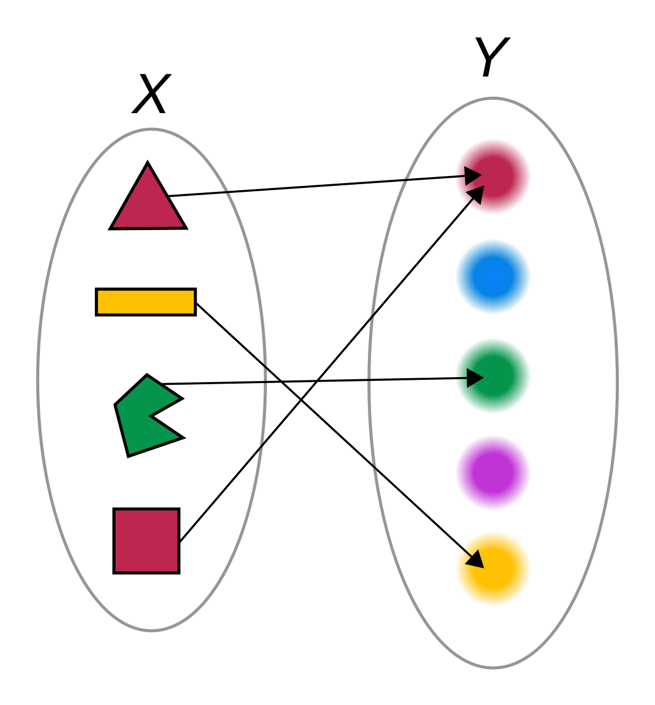
Rule based algorithm for New Redeemers
Product profile has categorical and sub categorical attributes which are on granular level.
(Ex: Photo Frames Decor, Kindle E books, Accessories Home Entertainment)
Customer profile derived from accrualtransmaster and redemptiontransmaster has subcategory attributes which are on aggregate level.
(Ex: Home, books music, Multi brand Electronics)
Ex: Multi brand Electronics
Home Theaters & Speakers Home Entertainment
sennheiser earphone cx213, etc
Product profile (Granular level)
Customer profile (Aggregate level)
Notes:
Issue for applying cosine similarity: 9 cr customers and there is huge difference between customer profile vector and product profile vector becoz product profile is more on granular level while customer profile is on aggregate level. Ex: Necklace wallets décor candles in product profile while Electronics, retail outlet, books music, home
Post mapping products could be recommended to customers on the basis of the product profile assigned to that customer.

Slide 11
Old Redeemers
Flow Process Chart
New Redeemers
Collaborative Filtering
(Recommends customized potential products based on historical redemption patterns(last 3 years))
Rule based algorithm (Mapping of customer profile and product profile)
Clustering (K Means)
Apriori Algorithm
Content Filtering
(Recommends products similar to previously redeemed products)
Cosine Similarity

Slide 12

Thank You

